Slide 1
Salary Analysis based on Ask A Manager Dataset
AM-01 Applied Statistics Final Presentation
Group 5
21st Sept 2021

Slide 2
Data Cleaning
>>> Step 1

Slide 3
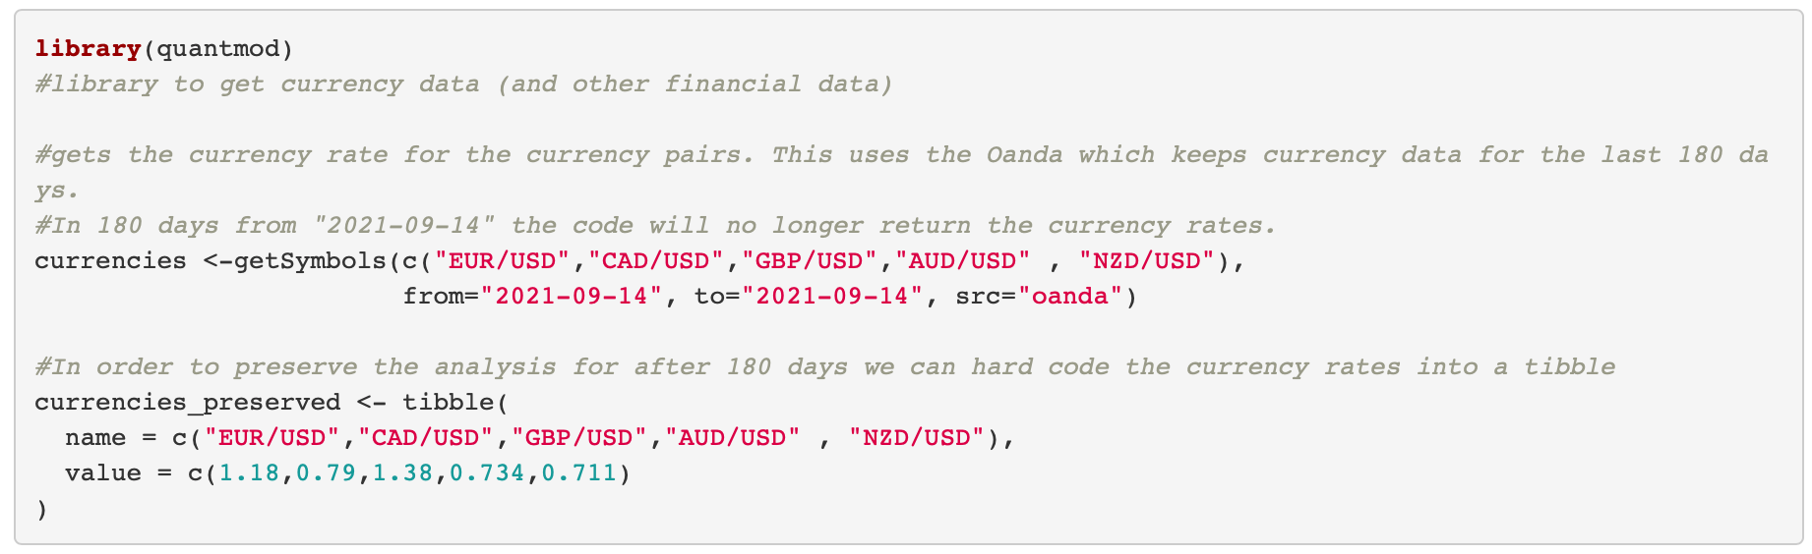
Five steps in data cleaning
Remove NA
By skimming the data, there were a lot of NA values and our first step is to remove NA values for certain variables
Remove outliers
There were certain data points that would have had too much leverage. Thus we removed outliers in target numerical variable of annual salary by using z-score. to remove data out of 3 sigma
Factor datatype
The large majority of explanatory variables for our target annual salary were character variables. We convert them into factor to run a linear regression
Select industry
As there are over 1,000 industries, we we selected only the top 25 industries reported (representing 92% of the total)
Unify currency
Since data in the salary survey involved multiple currencies we wanted to convert the salaries into a uniform currency to make the analysis more representative and accurate
This involved using a package called quantmod to get currency rates as of “2021-09-14” and using these rates to convert the currencies of “GBP, AUD, NZD, CAD, EUR” to USD

Slide 4
Explorative Data Analysis
& Statistical Testing
>>> Step 2

Slide 5
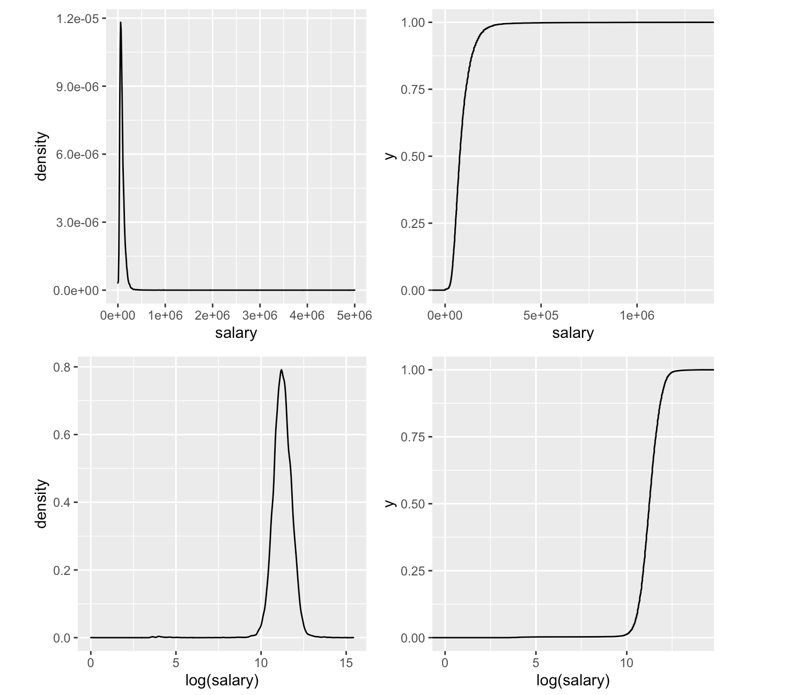
Salary Distribution
Density plot for salary and log_salary
First, we want to see the distribution of salary in the sample
We also created a log_salary variable to help aid in the visualizations of the salary distribution
Key Takeaways
The salary distribution is extremely right skewed

Slide 6
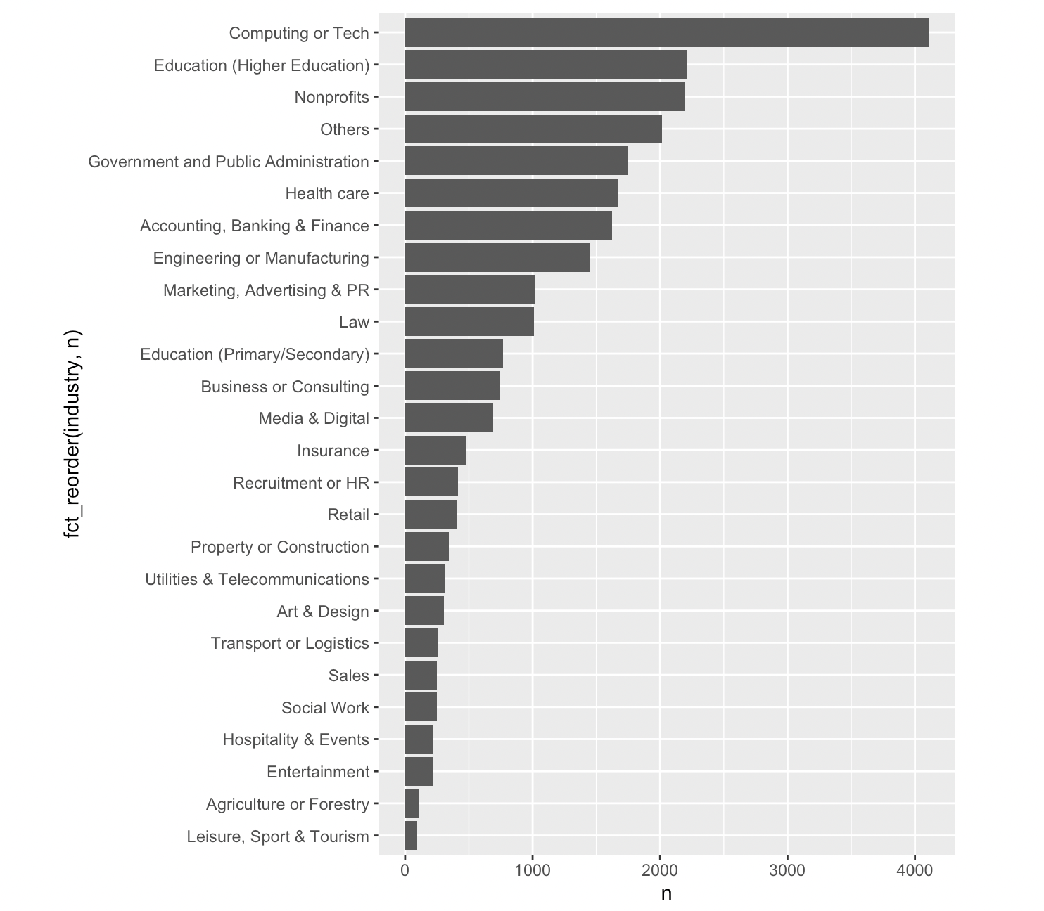
Industry Distribution
Bar chart for number of respondents within the top 25 industries
We want to know the industry distribution in the sample
We select the top 25 industries which accounts for c. 92% of total respondents
Key Takeaways
Computing & tech is the top-chosen industry among respondents, followed by Education and Non-profit
This indicate that the sample might include more respondents from industries have higher exposure to tech and internet

Slide 7
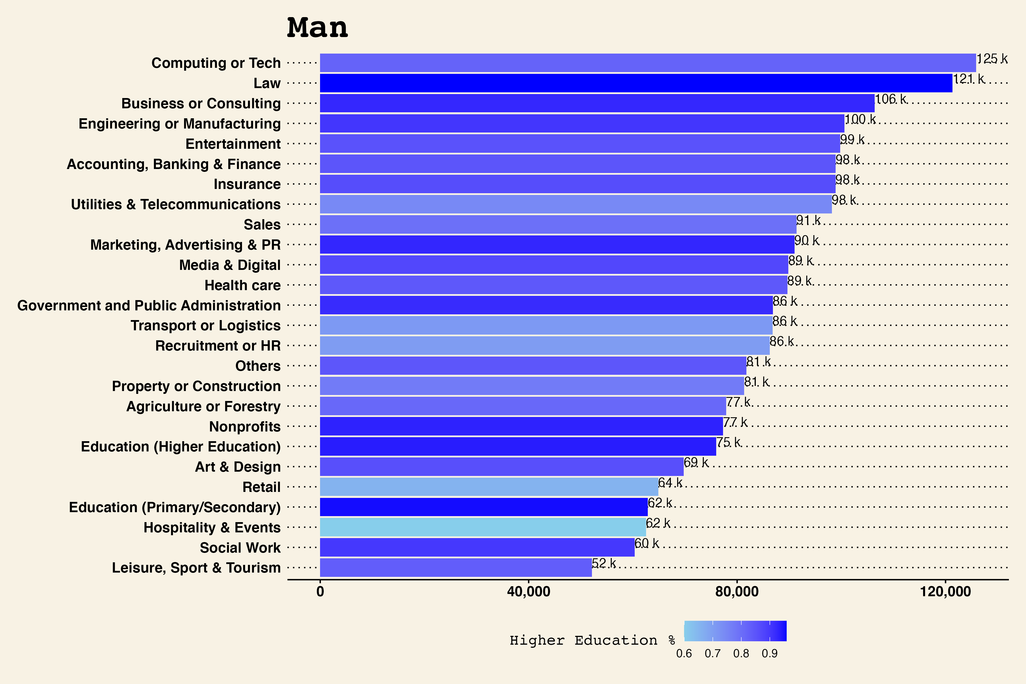
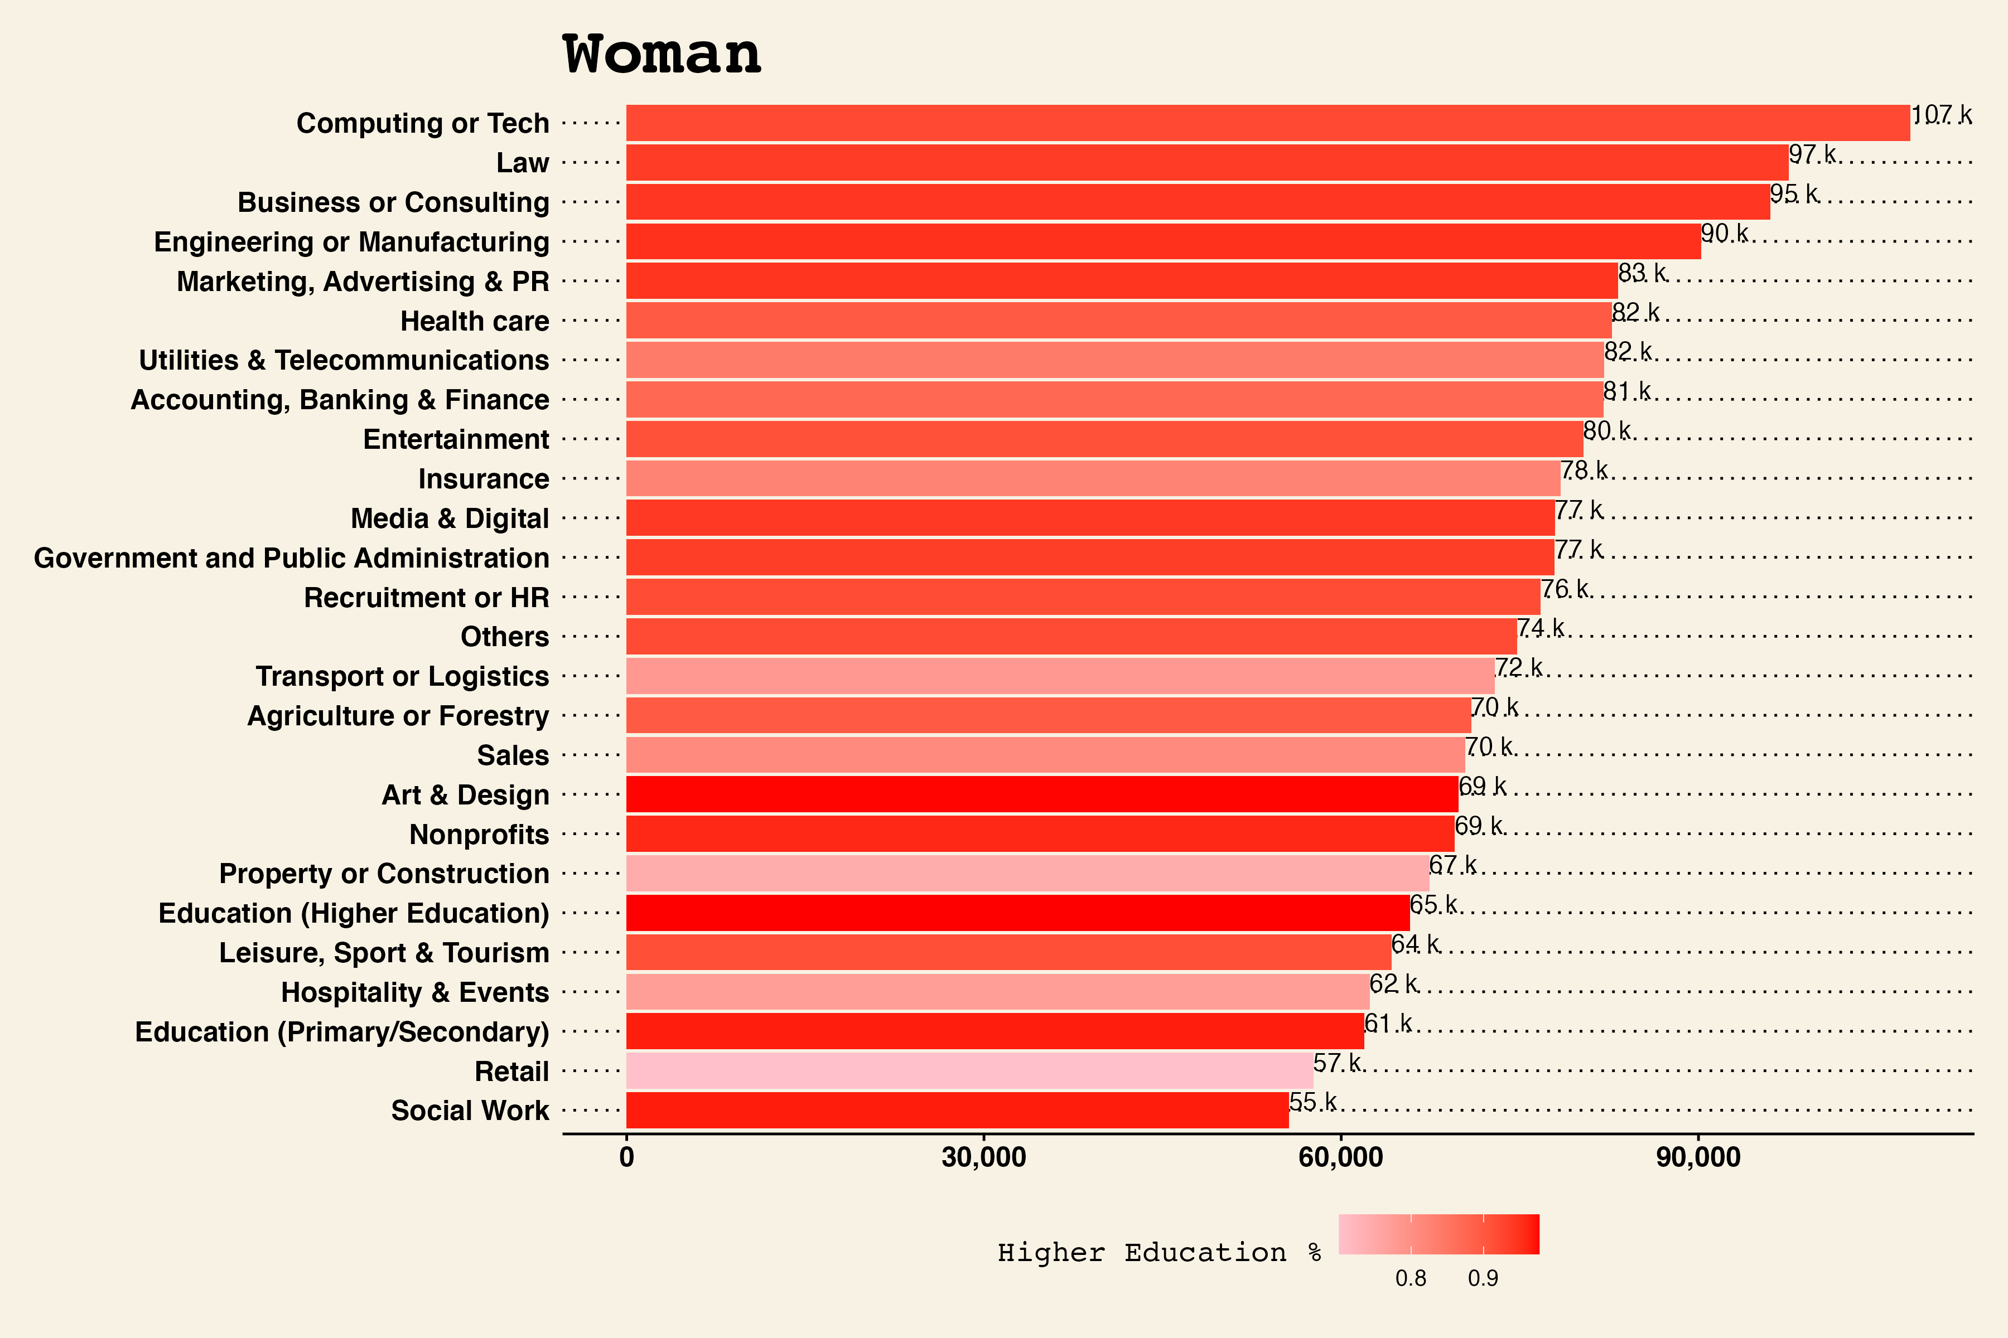
Gender and Salary (1/2)
Bar chart for average salary of woman by industry, color scaled by education level
We are interested in the type of industries with top salary for man and woman
Key Takeaways
For both man and woman, the top earning industries are alike (Law, Computing or Tech, Business or Consulting)
Respondents from Law, Govenment and Education tends to have higher education level compared to the rest, reflecting the academic/professional requirements of these positions
The difference between the salary within sales and accounting, banking & finance is likely due to the subdivisions chosen based on gender nature

Slide 8
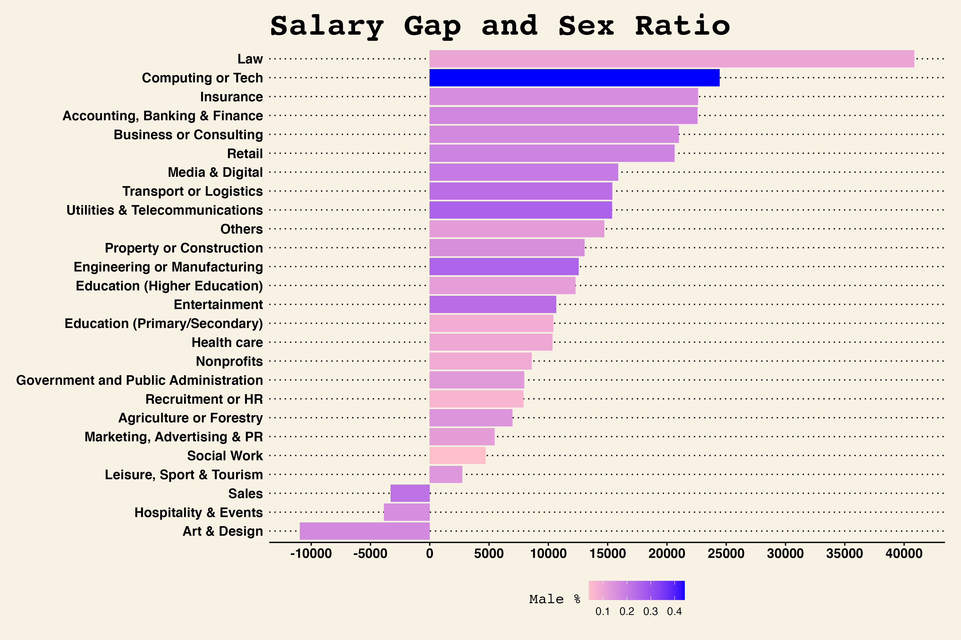
Gender and Salary (2/2)
Bar chart for gap in average salary between man and woman by industry, color scaled by sex ratio
We are also interested in the salary difference between man and woman within the same industry
Key Takeaways
Man has a higher average salary than woman in most of the industries, with Law being the most significant
Woman has higher average salary in Art & Design
The proportion of male within computing or tech is significantly higher than that within other industries
The proportion of male is also higher in labor-intensive industries such as transport, engineering, utilities
Male proportion is capped at 40%, revealing the fact that there is a gender limitation in the sample

Slide 9
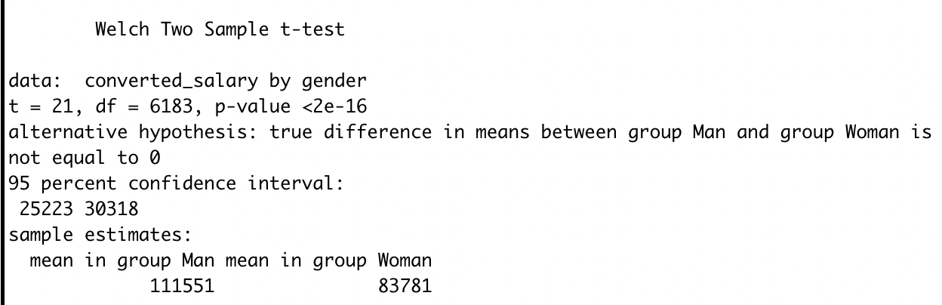
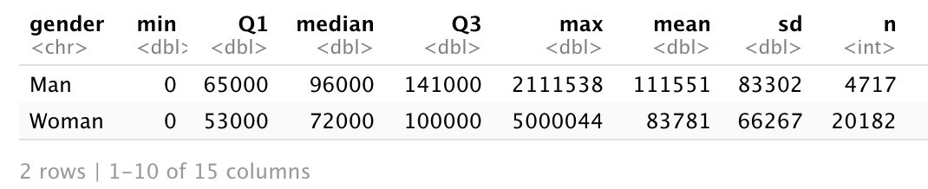
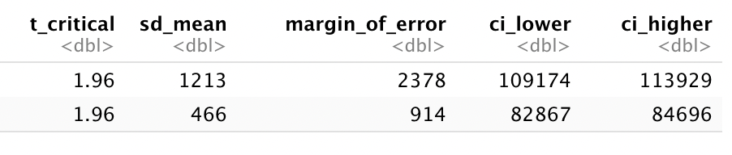
Gender and Salary
T.Test and Confidence Intervals for Mean Annual Salary for Men and Women
We want to explore if there is a difference in annual salary means for men and women
We also conducted a T.test and calculated a confidence interval for each mean
Key Takeaways
In our sample, mean salaries for men and women are statistically different, where women earn less on-average than men
t test
Confidence Intervals

Slide 10
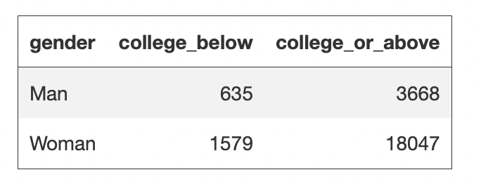
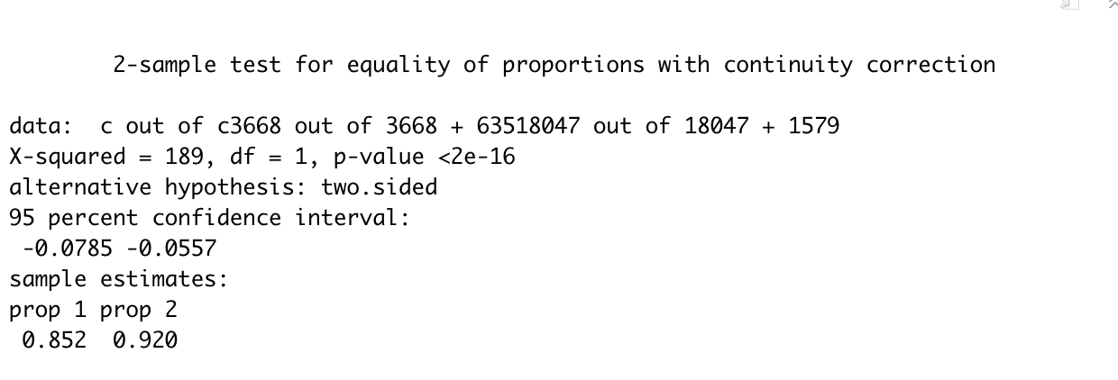
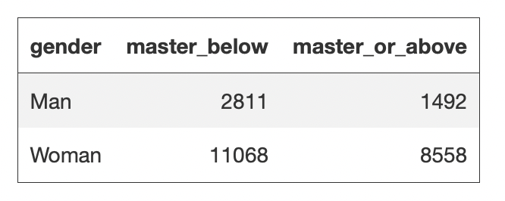
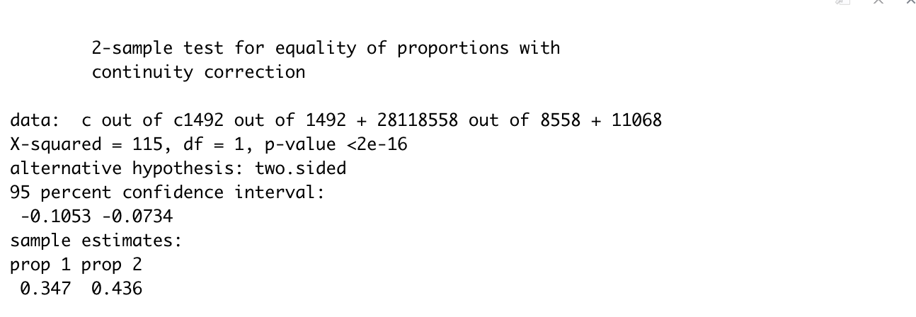
Gender and Education
Prop.test for college-or-above education level in the male group and female group
We want to explore if there is a difference in the education level for male group and the female group
The indicator we chose is college-or-above degree and master’s-or-above degree
Key Takeaways
Female has a higher college-entry rate vs. the male
However, the proportion of acquiring higher education degree (Master’s-or-above) is higher in male group
This somehow explains the fact that there are more outliers in male sample with extremely high income level
prop.test(x = c(3668,18047), n = c(3668+635,18047+1579), alternative = "two.sided")
prop.test(x = c(1492, 8558), n = c(1492+2811, 8558+11068), alternative = "two.sided")
Z

Slide 11
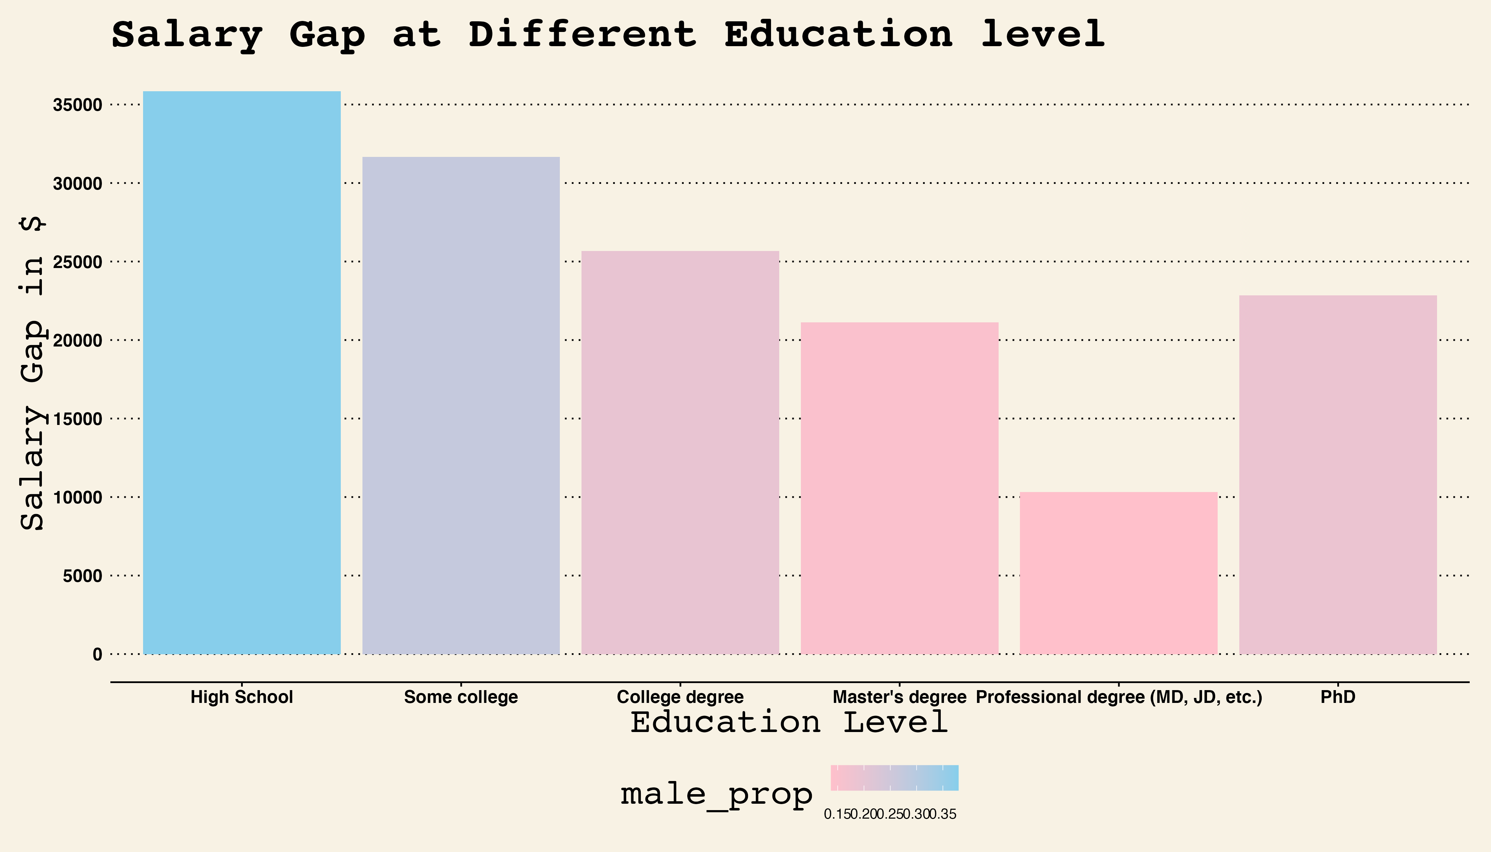
Education and Salary
Bar chart for gap in average salary between man and woman by education level, color scaled by sex ratio
We also want to see if there is a difference in the salary gap between man and woman for different education level
Key Takeaways
The gender gap is also prevalent within the respondents who have higher education levels
The pay gap between genders is highest at the high school level and gradually lowers until the professional degree level
This shows that as education levels increase, the salary gap gets lower. There is however an exception with the gender pay gap spiking with PhDs

Slide 12
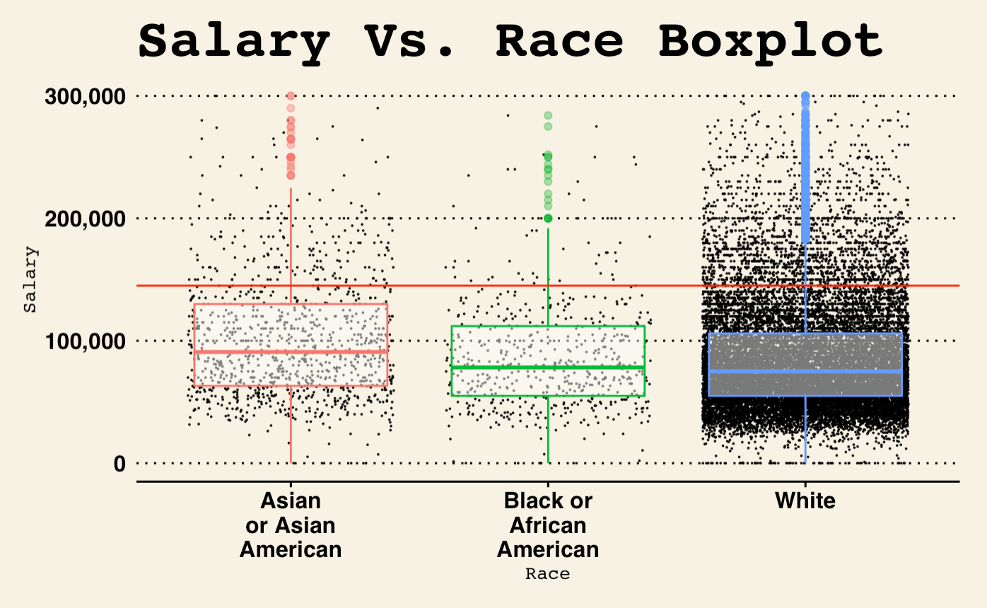
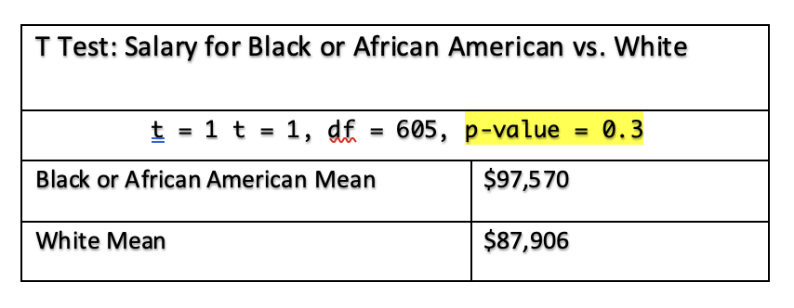
Race and Salary
Box plot for salary and race
Next, we want to see if there is a difference in salary among difference races
Key Takeaways
Asians have the higher salaries in comparison to Black and African American and White sample respondents
The medium salary for Black and AA respondents is higher than that of White respondents
Since most respondents were white, the larger sample size is less prone to skewness due to outliers when comparing it to the other two races portrayed in the plot
Observation:
In our boxplot one can visualize both the distribution of the data and the medium and interquartile ranges of the data. When comparing annual salary by race, our data shows that Asians have the higher salaries in comparison to Black and African American and White sample respondents. Interestingly enough, our sample also shows that the medium salary for Black and AA respondents is higher than that of White respondents.
Since most respondents were white, the larger sample size is less prone to skewness due to outliers when comparing it to the other two races portrayed in the plot.
Since the boxplots for the Black and African American race and the White race look visually similar, we conducted a T,test to calculate whether the difference was statistically significant. Due to us getting a P-value of .3, we can confirm that there is not significant difference in the average salaries of the two races.
Key Takeaways
The highest average earners in this dataset are those who are Asian or Asian American
On average, the salary of White and Black or African American races are not different in the sample.
Since the boxplots for the Black and African American race and the White race look visually similar, we conducted a t,test to calculate whether the difference was statistically significant
We can confirm that there is not significant difference in the average salaries of the two races.

Slide 13
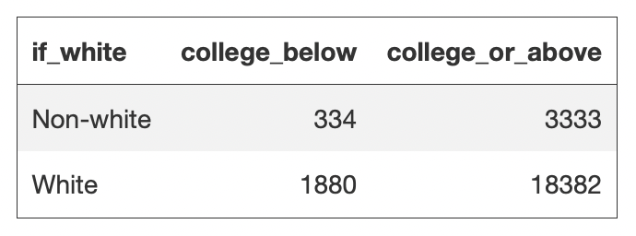
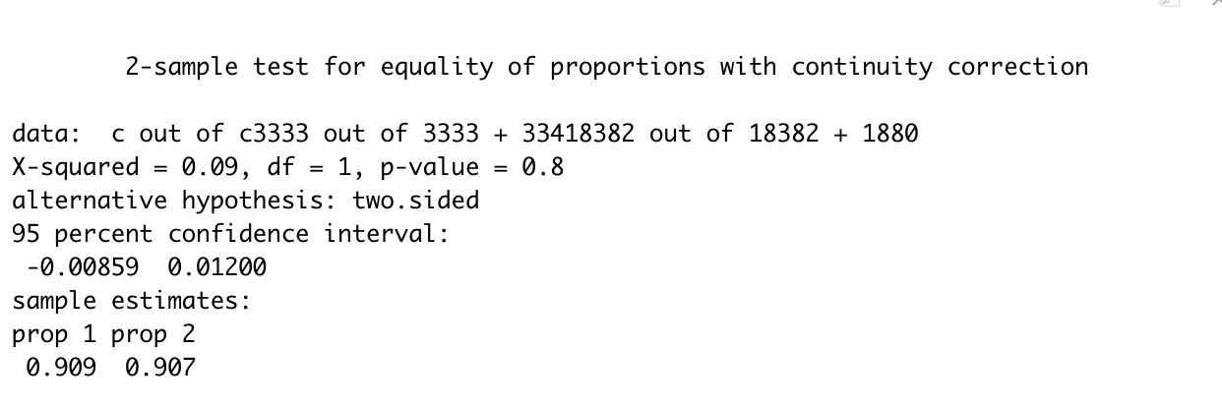
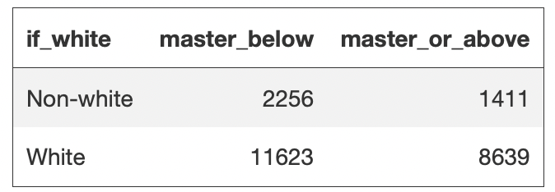
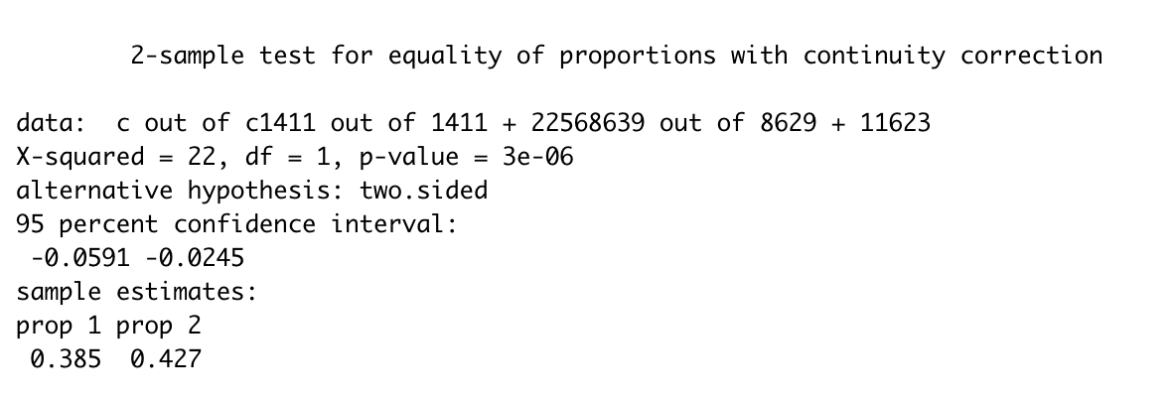
Race and Education
Prop.test for college-or-above education level in the white group and non-white group
We want to explore if there is a difference in the education level for white and non-white group
The indicator we chose is college-or-above degree and master’s-or-above degree
Key Takeaways
There isn’t a significant difference in the college-entry rate for white and non-white
However, the proportion of acquiring higher education degree (Master’s-or-above) is higher in the white group vs. other races
prop.test(x = c(3333,18382), n = c(3333+334, 18382+1880), alternative = "two.sided")
prop.test(x = c(1411, 8639), n = c(1411+2256, 8629+11623), alternative = "two.sided")

Slide 14
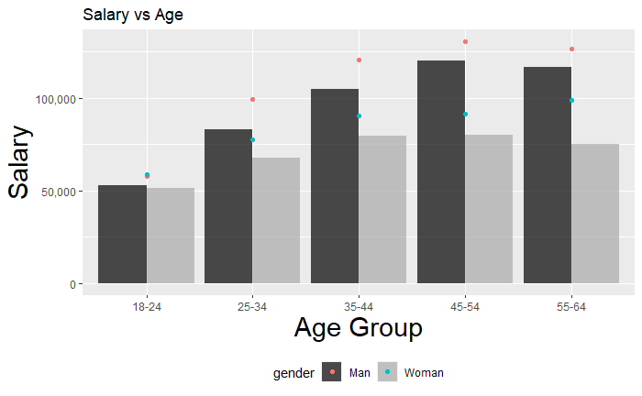
Age and Salary
Bar chart for mean and median salary in each age group by gender
We want to know how the age group affects the salary in the male and female employees
Key Takeaways
Between 18-24, the prime years where employees start their careers, the pay of males and female is similar
As the average age increases, the gap between differences in salaries between male and female widens
Height of the bars represent the median salary
Points represent the mean salary for each gender within each age group

Slide 15
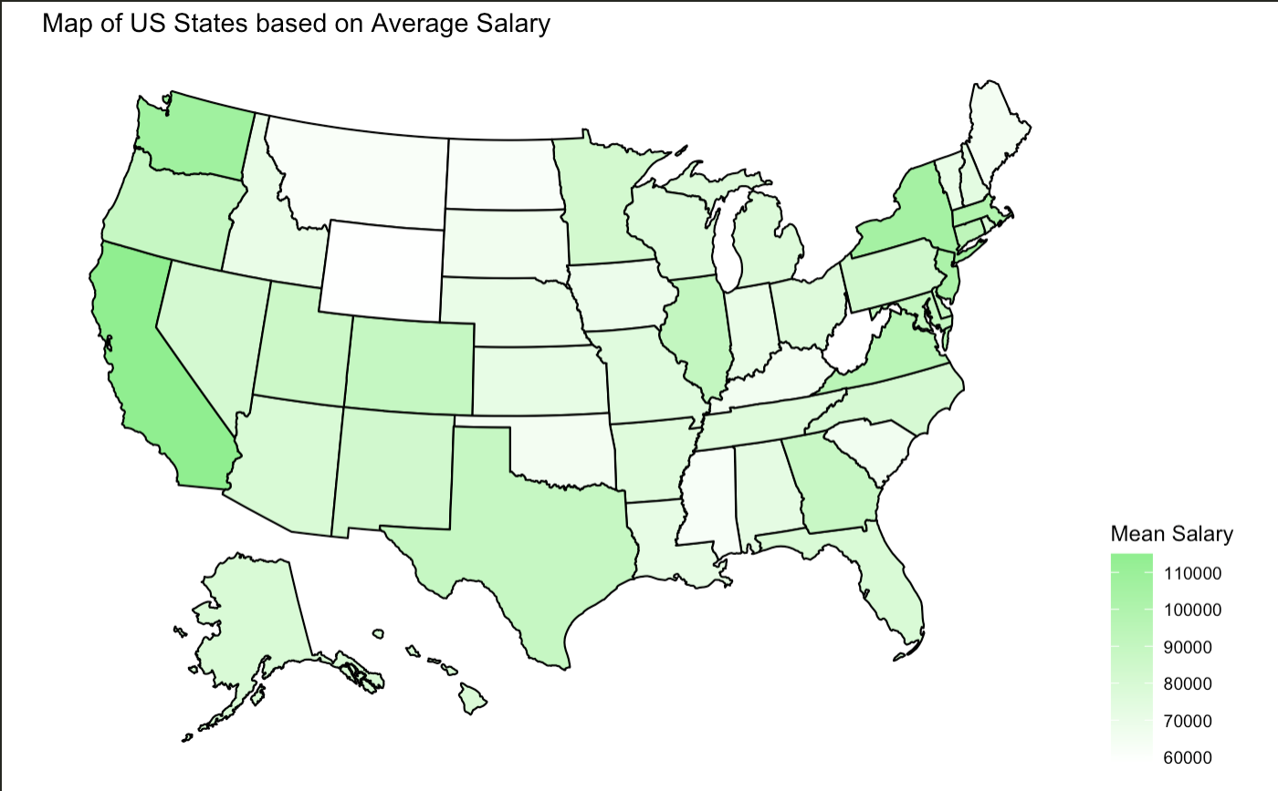
Geography and Salary
US State Map color scaled by average salary
Here we use a visualization of the US states to get a better idea of the states with the highest average salaries.
Key Takeaways
As we can see California, Washington and New York all had very high average salaries
This is possibly related to the allocation of higher paid industries, such as computing or tech
Individuals wanting to earn higher salaries may benefit from moving to these states.

Slide 16
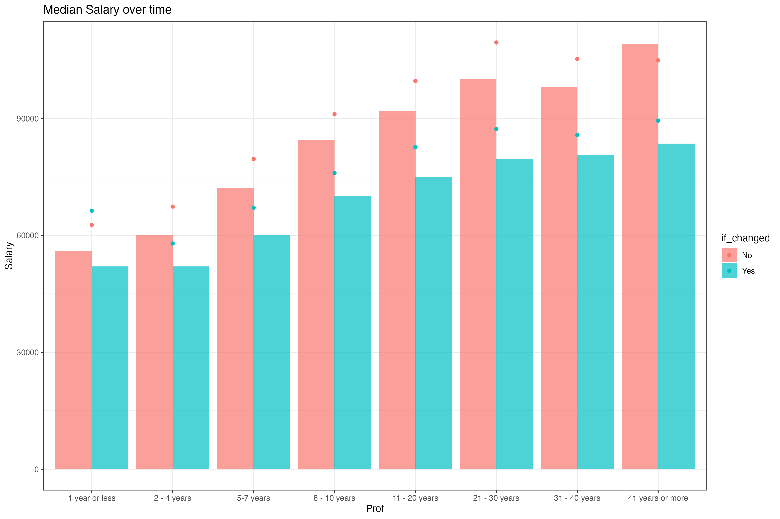
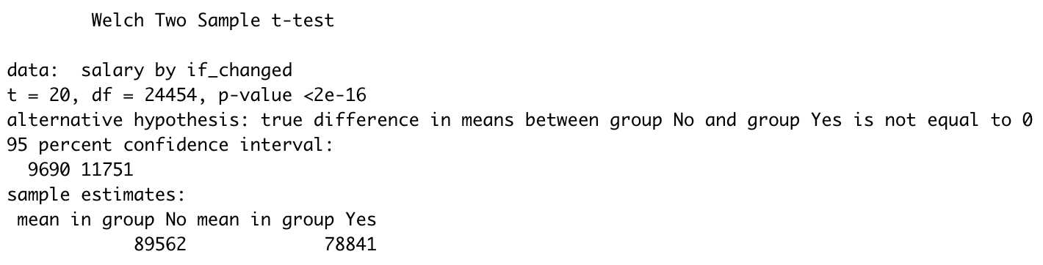
Switching Industry and Salary
Bar chart for mean and median salary if switching industry
Finally, we want to evaluate whether switch industry affect the salary
Key Takeaways
The greater the amount of experience the greater salary difference between those who switch and those who don’t
The percentage increase in salary with increasing professional experience is proportional
The outliers for the data were predominantly those who switched industry

Slide 17
Regression Modelling
>>> Step 4

Slide 18
Regression Model Summary
The variables that had a significant impact on salary were experience in a specific field, industry type (data related jobs, etc.), race, and population of the state in which the respondent lives in. By taking these into account, we created a model with an adjusted r-squared of circa 42%. This means that the variables imputed in the model explains 42% the proportion of variability in annual salaries of the respondents.
Experience in a specific field explains more variance of salaries than the variables of age and the years of professional experience in total.
Data related jobs are averagely paid higher by $5046 than other jobs, scientists are paid higher by $8820.476 and data scientists are paid higher by approximately $31300 in the survey. However, doing a database related job has an average annual salary of $12360 lower than average. Engineers on average earn $22182 more per year and managers earn $7987 more than average. Finally, doing a research job has no significant positive effects on salary.
Races do have influences on salaries in the survey. Asians (4.54% of the respondents) earn the most and white people (84.68%) earn the lowest on average. That may be caused by the bias of sampling.
Population of the state has positive effects on average salary. People in a state with 1 million more people averagely earn $383 more.
As we added variables to our model, the RMSE and the R-squared improved in both out train and test data. The performance of final model RMSE on train data: 28801. RMSE on test data: 28398. The fact that these numbers are not too different gives us confidence that we did not overfit our data but still space to improve. Furthermore, the R Squared on train data is 42.30% and the R Squared on the test is data 44.23%, which is also not a large difference. It makes sense that our train data R Squared is lower, as it was run on a smaller sample.

Slide 19
Summary
Gender and Salary
Overall, there is a statistically significant salary gap between men and woman in the dataset
The largest gap is seen in the Law industry, which has on average a $40,000 difference in salary between men and woman.
In comparison, in the Leisure, Sport & Tourism, Education, and Agriculture or Forestry industries the gender gap switches, as woman have higher average salaries in the fields. For both men and women Law is the industry with the highest salary levels
Gender and Industry
The proportion of male within computing or tech is significantly higher than that within other industries
The proportion of woman within social work and recruitment or HR is significantly higher than that within other industries
Education and Industry
Individuals working in law have the highest education levels
As education levels increase, the salary gap gets lower, with exception with the gender pay gap spiking with PhDs
Professional Experience / Change in Industry and Salary
As years of experience in the field increased, average annual salary also increased
There is a difference in average salary between those that remained in the same industry and those that switched
Regression Models
The variables that had a significant impact on salary were experience in a specific field, industry type (data related jobs, etc.), race, and population of the state in which the respondent lives in.
By taking these into account, we created a model with an adjusted r-squared of circa 42%. This means that the variables imputed in the model explains 42% the proportion of variability in annual salaries of the respondents.

Slide 20

Thank you!

